Slide 1
GOODREADS Back-end Clone

Slide 2
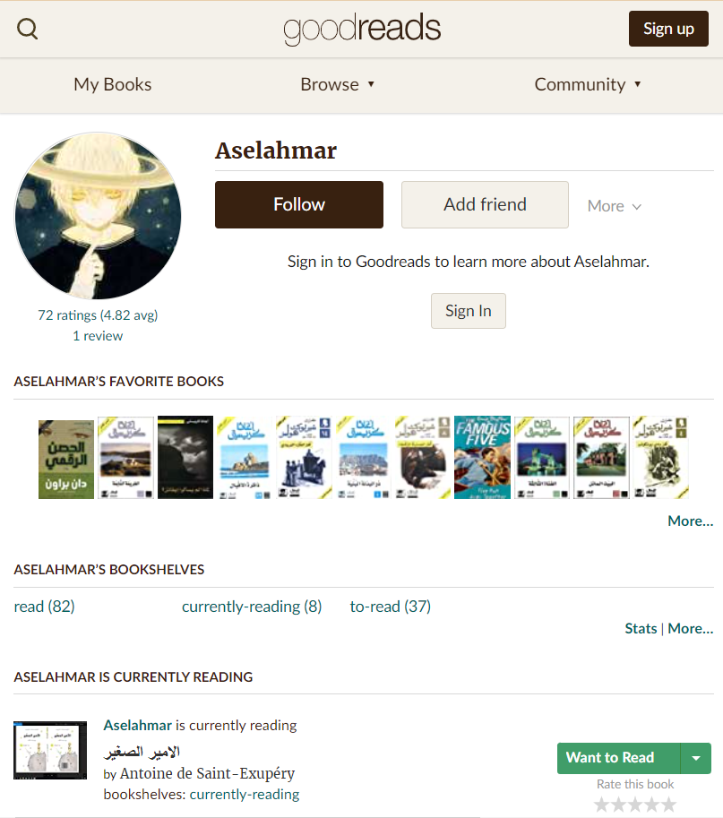



Overview of GOODREADS

Slide 3
Our process is easy
BOOKS
ToRead
Reading
1
2
3
Read
Fav. BOOKS
USERS
2
3
1

Slide 4
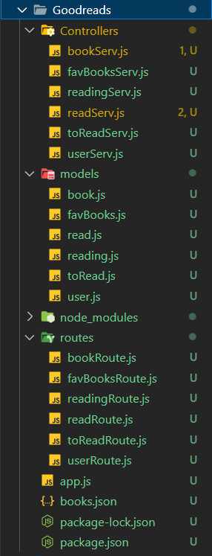
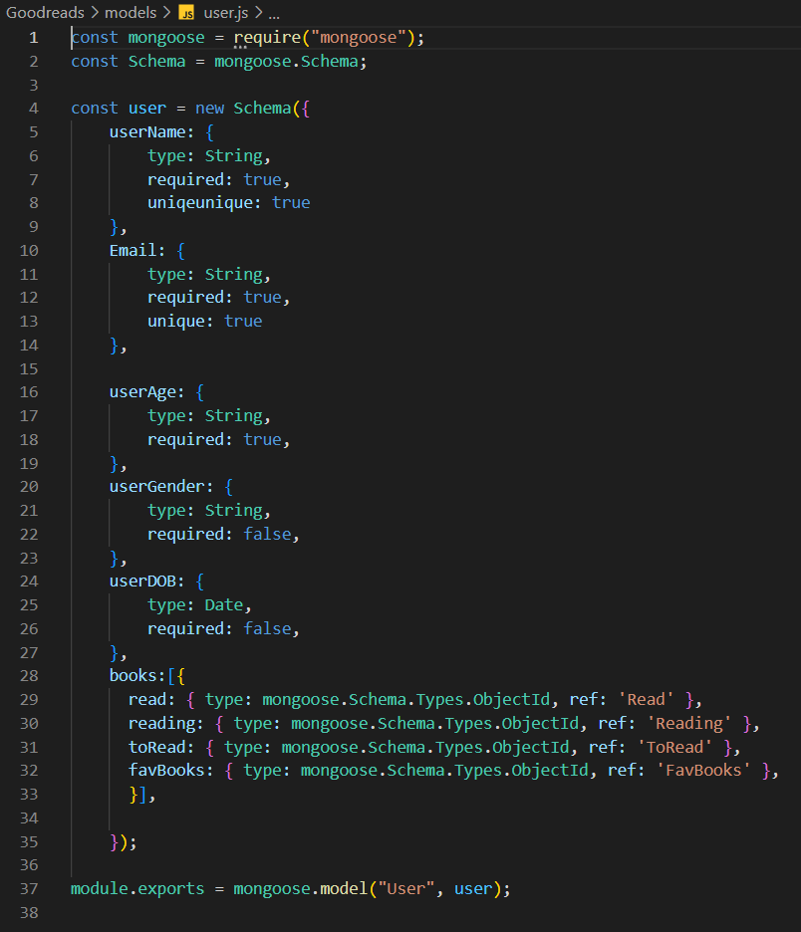
Main code structure

Slide 5
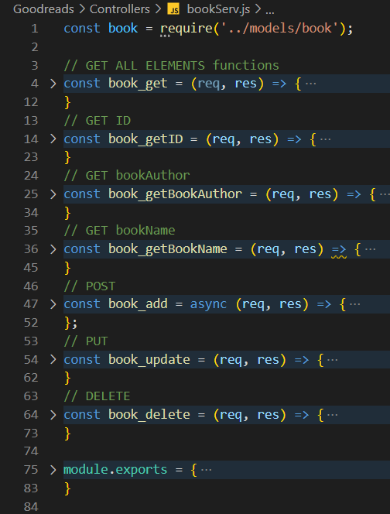
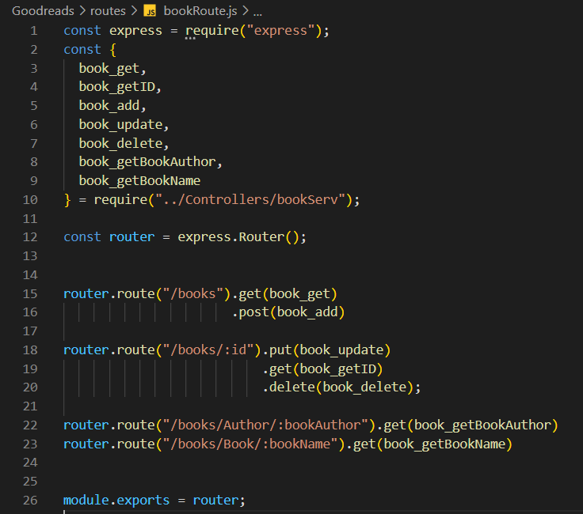
Main code structure

Slide 6
Thanks!

